Slide 1
Electronic Health Records, Personal Health Records & Health Information Technology
Brenda F. Bell
ACGNJ “Window Pains” Meeting
18 November 2011

Slide 2
The Face of Healthcare Today
Most of us have several doctors
Primary care physician
Regular dental, optical, specialist providers
Occasional specialist consultations
Most of us don’t have copies of our medical records
Healthcare provider (HCPs) see them as proprietary
We forget to ask for (and keep!) personal copies
We don’t archive all our medical records together
Notes:
Many of our doctors either still use paper records, or don’t share those records with us or with our other doctors. Often if we go outside the doctor’s office for imaging diagnostics, the doctors get the technician’s analysis only – without the images. Often, we don’t get the images either.

Slide 3
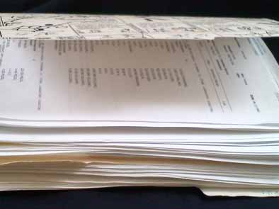
“Old School” Personal Medical Record
Many doctors are still only able to access patient information – especially information from other healthcare providers – this way.
Notes:
Yes, I bring this with me to every doctor’s appointment. And if a doctor wants to keep a copy of the paper, I make sure he returns MY copy to me.

Slide 4
Paper Records
Can get lost
Can get misfiled
Can get damaged by water, fire, light, etc.
Hard to share – only one copy exists (unless scanned or photocopied)

Slide 5
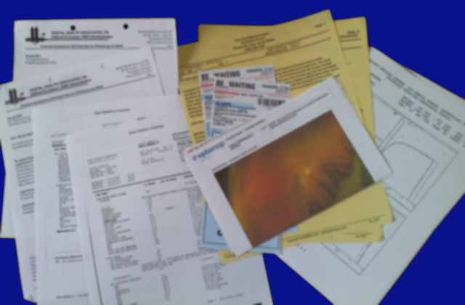
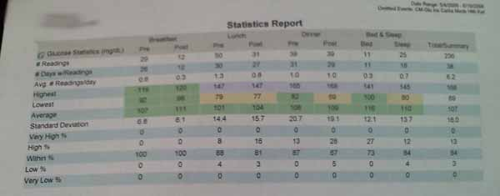
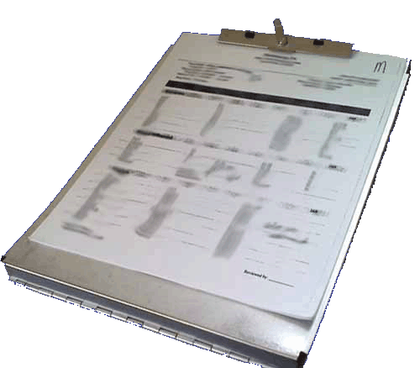
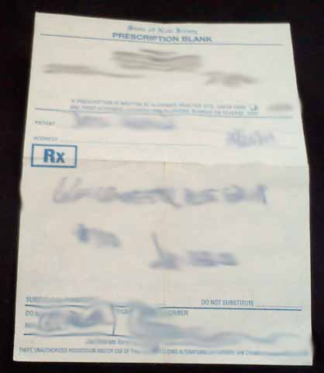
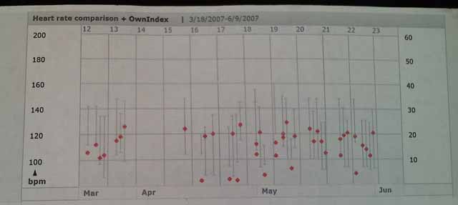
Many Data Sources, One Patient

Slide 6
Your Medical Record Includes
Test reports
Prescriptions
Doctors’ instructions
Hospital discharge papers
Images and their interpretations
Personal medical logs
Health Insurance Explanations of Benefits
Healthcare bills and receipts

Slide 7
Traditional Health Records
Are not shared with other doctors
Diagnostic tests are unnecessarily repeated
Needed tests may be omitted
Key signs and symptoms may be missed
This leads to
Delays in diagnosis
Incorrect diagnoses
Incorrect, unsuitable, and even dangerous therapies

Slide 8
Reasons to Keep Personal Copies
Income tax deductions
Keeping track across multiple healthcare providers
Filling in crucial medical history
Avoiding unnecessary duplication of efforts
Keeping track over time
Better understanding your health

Slide 9
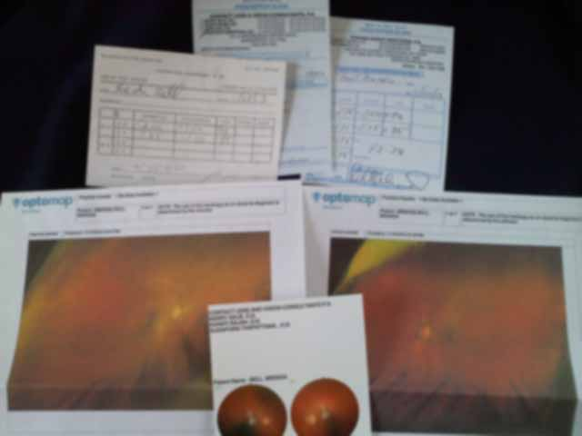
One Medical History
Prescriptions and retinal scans across eight years and three eye-care providers.

Slide 10
Why Go Electronic?
Data security: “backup” copies
Analyze trends from a single source
Correlate information from multiple sources
Avoid unnecessary duplication of efforts
Faster and more accurate diagnoses
Appropriate therapy
Faster fulfillment (pharmaceuticals, payments)
Federal funds (Healthcare Information Technology Incentive)
Faster access to patient health information

Slide 11
Going Electronic – Stage 1
At the doctor’s office:
Automated insurance billing codes
Digital x-Rays
e-Prescriptions
Scanning in patients’ back-records
e-FAXed lab reports
At home:
Scanning written prescriptions, drug info, reports
Keeping a health log

Slide 12
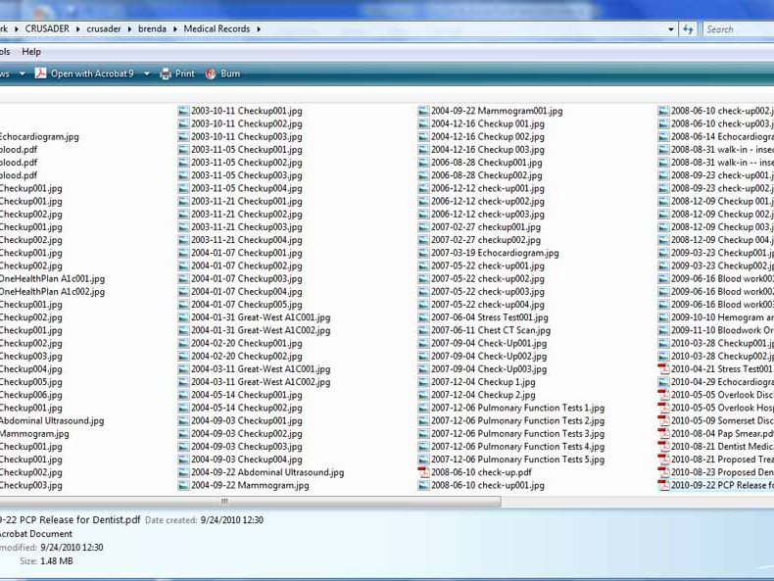
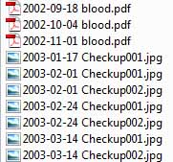
Managing Paper Medical Records
Scanned into a single directory, labeled with date and purpose of record

Slide 13
Going Electronic – Stage 2
At the doctor’s office
Consulting patients’ back files
Immediate submission to insurance companies
Secure patient portals to provide test results
At the insurance company
Patient portals expand to provide
Education
test results
Logging applications
Improve accountability and coordination of care

Slide 14
Going Electronic – Stage 2
At home
Analytic logging
Using longitudinal data to determine health trends
Examples: Excel, medical-device software
Portability
Files copied to flash drives, CD-ROMs
Extra copies can be made or printed to share with healthcare providers
Some software allows data-sharing with HCPs

Slide 15
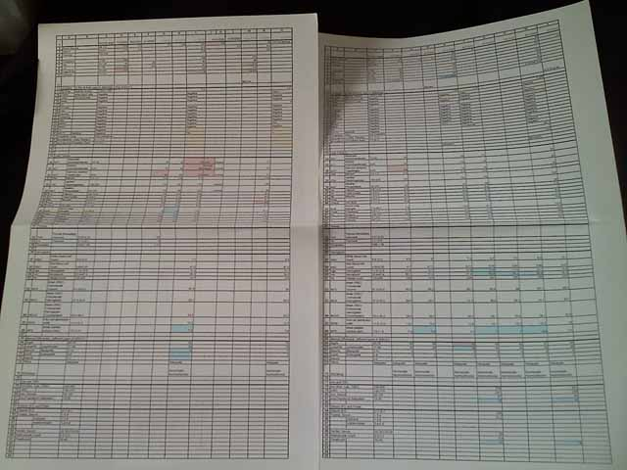
Log Printout
Patient’s regular bloodwork reports are entered into an Excel spreadsheet. A longitudinal view of “patient-normal” readings develops over time.

Slide 16
Into the Cloud!
Medical records accessible anytime, anywhere
Specialists’ offices
Emergency rooms
First Responders and Paramedics
Web-based analytical tools
Social Health
Leveraging social media to improve patient outcomes

Slide 17
HIPAA
Health Insurance Portability and Accountability Act of 1996
Addresses the use and disclosure of individuals’ health information by organizations subject to the Privacy Rule, as well as standards for individuals' privacy rights to understand and control how their health information is used.
Who is protected?
Health plans, HCPs, healthcare clearinghouses
While patients’ consent must be obtained to treat, patients are not covered by requirements of confidentiality, nor does this give them a priori rights to their personal health data.
This means that all those HIPAA regulations are protecting your doctors (and the government), not you.

Slide 18
“Meaningful Use”
The use of health information to improve HCP accuracy and efficiency, reduce costs, and improve patient outcomes
A set of federally-imposed reporting requirements that HCPs are required to meet by 2015
Incorporates e-prescribing and drug interaction checks; can include test results in structured-data formats

Slide 19
Alphabet Soup
HIT – Health Information Technology
EHR – Electronic Health Record
PHR – Personal Health Record
EMR – Emergency Medical Record (also Electronic Medical Record)
PPACA – Patient Protection and Affordable Care Act
HITECH – Health Information Technology for Economic and Clinical Health Act
mHealth – Mobile Health

Slide 20
Health Information Technology (HIT)
The whole shebang: EHRs, PHRs, EMRs, mobile access, analytical logging, etc.
Includes health information applications, portals, accessories, and devices

Slide 21
Electronic Health Records (EHRs)
aka EMR (Electronic Medical Record)
HCP-owned and -operated
Secure records stored in vertical-market applications
Patient access to records is limited; methods of correcting errors have not been satisfactorily addressed
“Meaningful use” criteria must be met
Issues of healthcare identity theft have not been addressed by application providers

Slide 22
Personal Health Records (PHRs)
Patient-owned and –operated
HCP read/write access is by the patient’s choice
Stored in large online systems such as Microsoft Health Vault
Record security and integrity have not been addressed to users’ satisfaction
Issues of health identity theft have not been addressed to users’ satisfaction

Slide 23
Emergency Medical Records (EMRs)
Not to be confused with Electronic Medical Records (EHRs)
Patient-owned and –operated
Limited data set designed for quick access by first responders
Specifically includes health-insurance information
Not limited to people with severe health issues (asthma, allergies, etc.)
Examples: Medic Alert, RoadID (interactive)

Slide 24
Patient Protection and Affordable Care Act (PPACA)
Also known as “healthcare reform” or “Obamacare”
Includes HIT requirement for all HCPs
Long-term goal is a single, national EHR database (or a set of interoperable systems)
Data mineable for public health and pharmacological research
Any HCP can access a patient’s record to provide care
Complete patient information for more accurate medical decision-making

Slide 25
Health Information Technology for Economic and Clinical Health Act - HITECH
Sometimes called the Health Information Technology Initiative
Integral part of the PPACA
Requires and incentivizes HCPs to move records to an approved patient management application
Standardizes information requirements and data formats
End expectation: one integrated medical record per patient, to be used by all his HCPs

Slide 26
Mobile Health (mHealth)
The ability to manage one’s health through mobile devices, accessories, and applications
Includes iOS- and Android-based applications, smartphone/device data connections, medical measurement devices
FDA has been soliciting comments à propos providing advice on these devices, cables, and applications

Slide 27
Improving Mobility
Handheld Scanners
Today: Bar-coded, basic patient information
Tomorrow: Context-moderated access to patient EHR, EMR, PHR
Medical IDs and EMRs
Today: ID jewelry indicates basic condition, authorization codes to view EMR on laptop computer
Tomorrow: ID jewelry automatically links EMT scanner to EMR, EHR
Health logging
Today: Requires data cable and connection to laptop computer, Internet
Tomorrow: Log and upload from anywhere.

Slide 28
Looking Ahead
Integration of EHRs, PHRs, through Health Information Exchanges (HIEs)
Standardized data formats
Improved patient access to medical records
Mobile and multiple-device data integration
Meaningful per-patient analysis
Meaningful use of population-wide data
Therapeutic and research applications of EHR/PHR data mining
Public health applications of EHR/PHR data mining

Slide 29
Resources
Patient Protection and Affordable Care Act (PPACA) http://www.gpo.gov/fdsys/pkg/PLAW-111publ148/content-detail.html
The “Meaningful Use” Regulation for Electronic Health Records, New England Journal of Medicine, 5 August, 2010 http://www.nejm.org/doi/full/10.1056/NEJMp1006114
HIMSS pages on Electronic Health Records http://www.himss.org/ASP/topics_ehr.asp
Healthcare Insurance Portability and Accountability Act (HIPAA) http://www.hhs.gov/ocr/privacy/hipaa/understanding/summary/index.html
Patient Privacy Rights http://patientprivacyrights.org/

